Slide 1
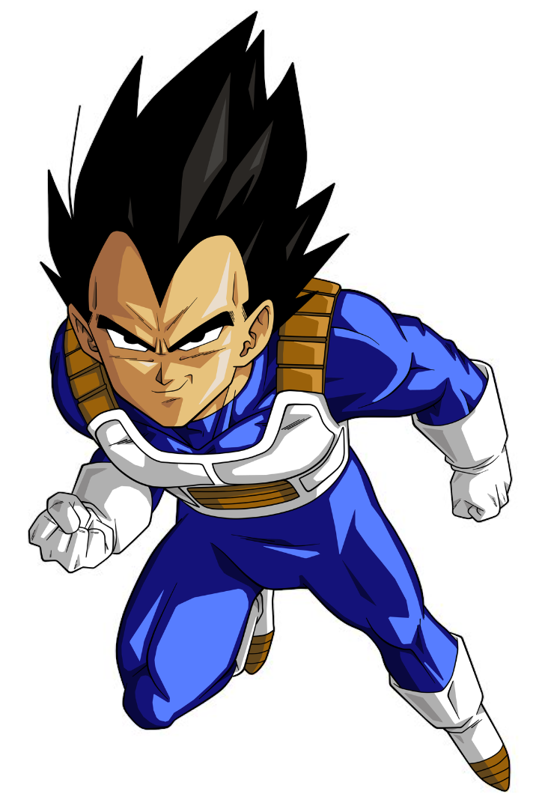
Vegeta, the Prince of all Saiyans
(In Dragon Ball Z)

Slide 2
Vegeta's Background
Royal Saiyan Bloodline
Prince Turned Warrior
Vegeta hails from a noble Saiyan bloodline as the prince of the planet Vegeta.
He was trained from a very young age to become an elite warrior
Personal goal
Saved by his disobedience
He wanted to become the strongest warrior in the universe even if it meant to betray his own race.
He didn´t obey Frieza orders of coming to planet vegeta when he destroyed it.

Slide 3
Vegeta's Background
Arrival on planet Earth
Finally, Vegeta arrives at planet Earth and starts his big adventure with the Z Warriors.

Slide 4
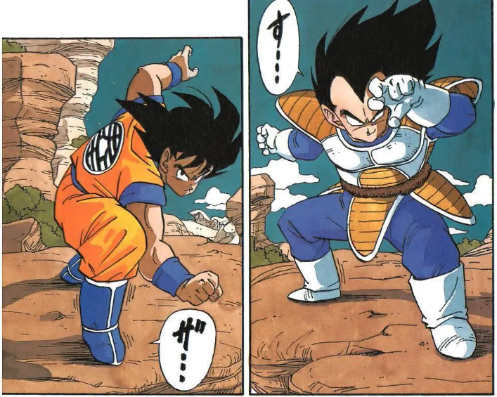
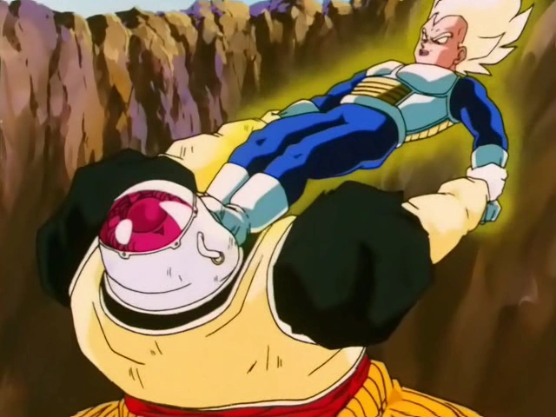
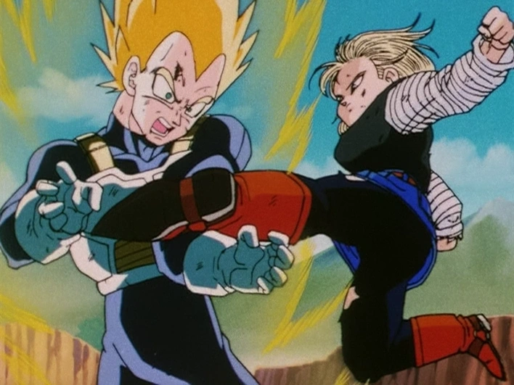
Battles
VS Goku
VS A 19 & 20
VS A 18
Provably the most memorable
His first appearance as a super saiyan
When his pride was damaged again

Slide 5
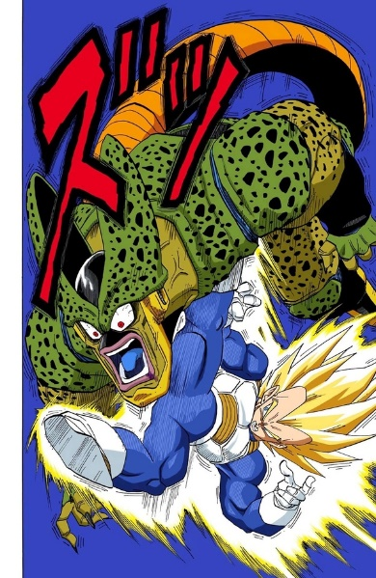
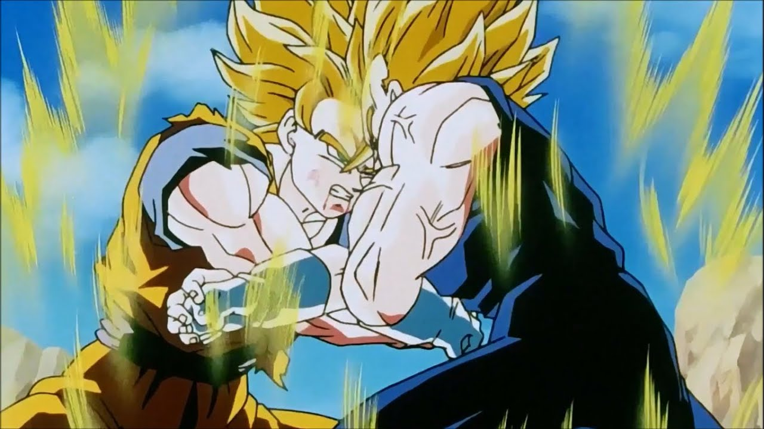
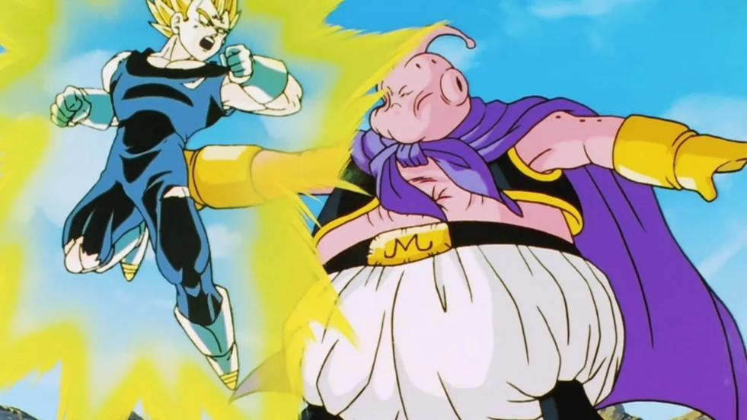
Battles
VS Cell
VS Goku 2º
VS A Majin bu
Coming back from his training stronger than ever
Tying up a loose end with goku
Trying to fix the problem he created

Slide 6
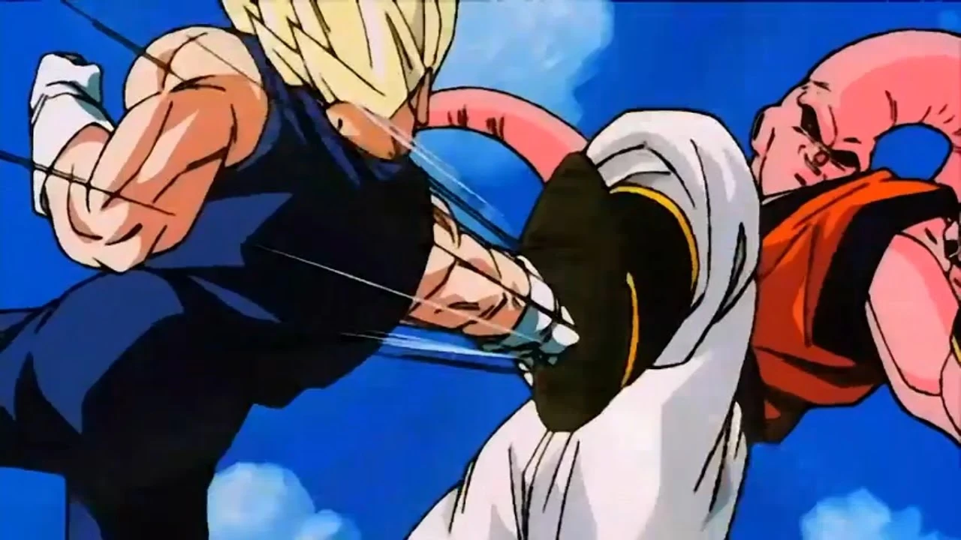
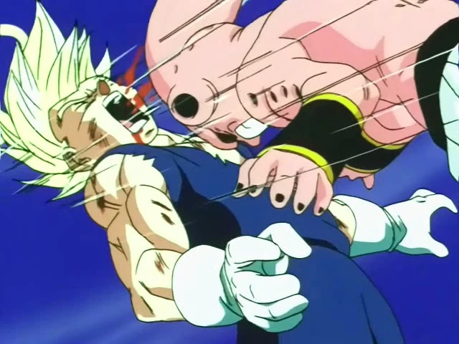
Battles
Different versions of bu

Slide 7

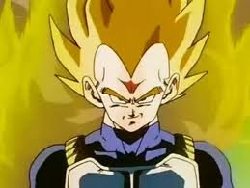
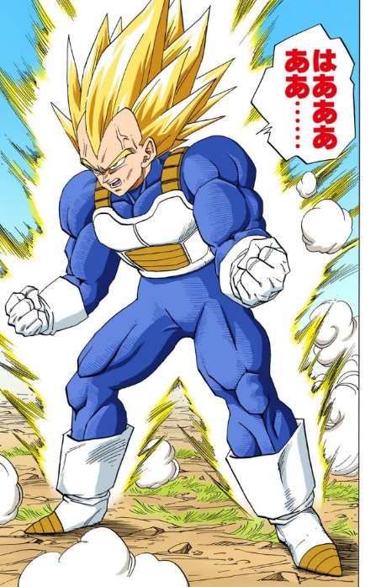
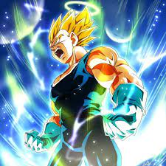
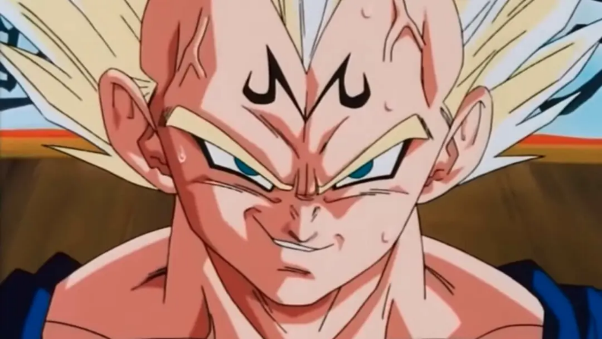
Vegeta’s transformations
1
Super Saiyan
2
Super Saiyan (buffed)
4
Majin Vegeta
3
Super Saiyan 2

Slide 8
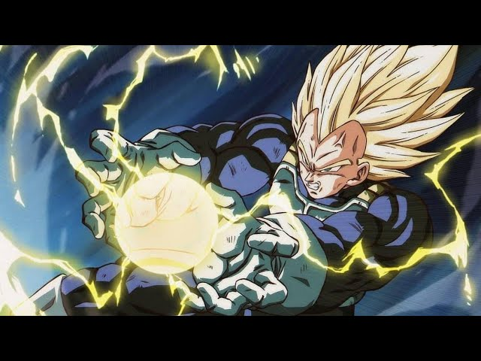
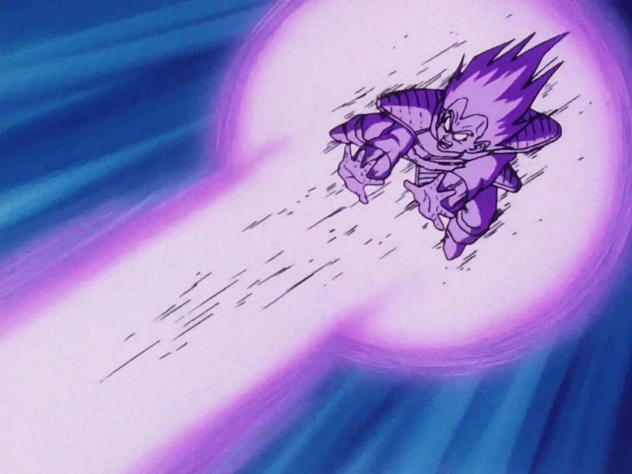
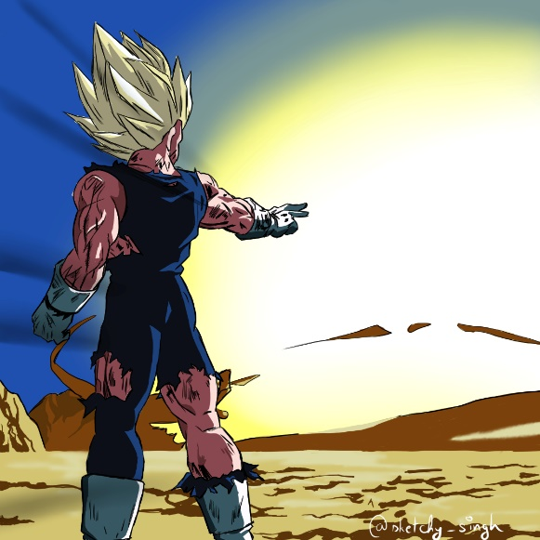
Some of Vegeta’s Atacks
Final Flash
Galick Gun
Final impact
Probably the most impressive attack
His most iconic one
In his fight vs Majin Bu

Slide 9
What We Can Learn from Vegeta
Determination
Growth and Redemption
Strength in Unity
Vegeta's unwavering determination teaches us the importance of relentless pursuit towards our goals.
Through his evolving relationship with Goku, Vegeta shows the power of unity and teamwork in achieving greatness.
Vegeta's character growth and redemption arc inspire us to learn from our mistakes and become better individuals.

